Slide 1
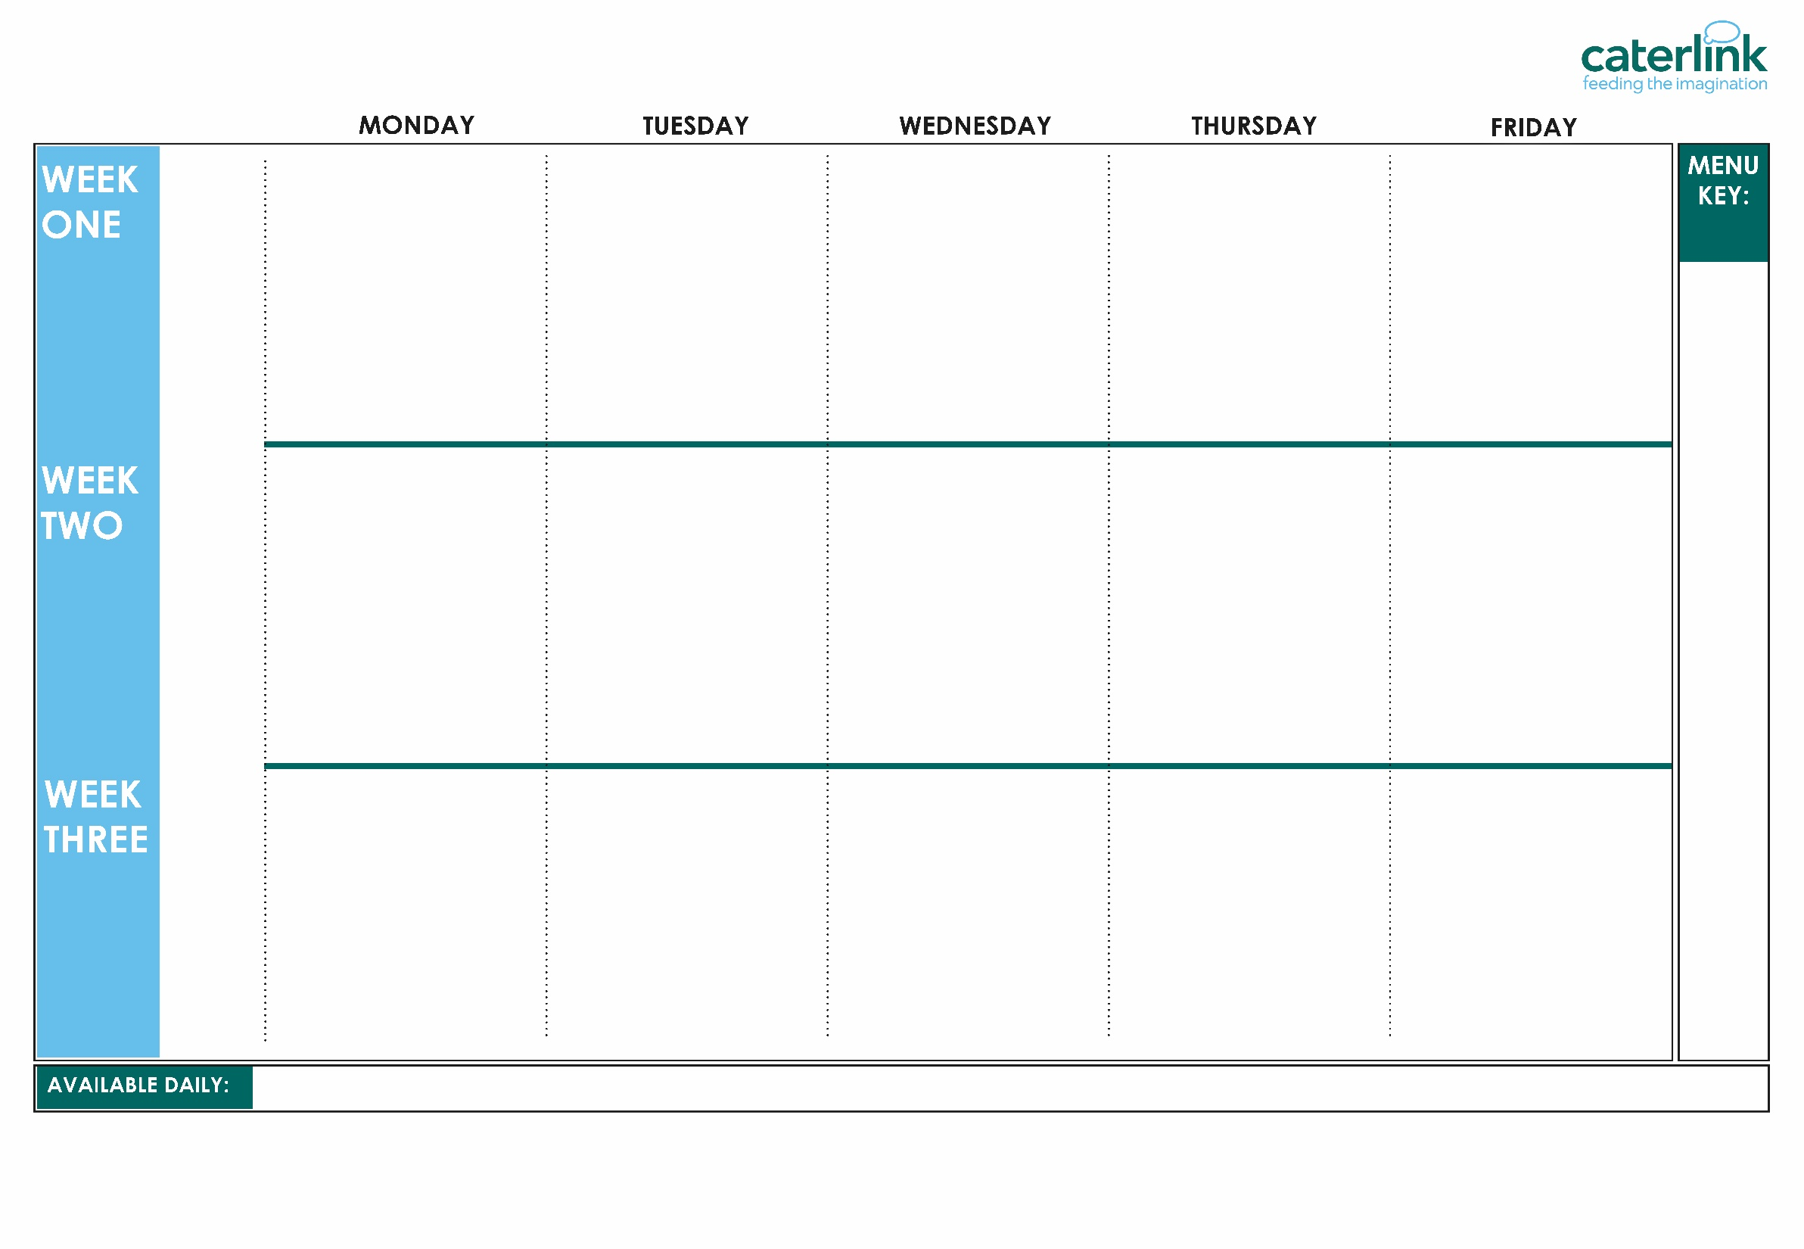
AUTUMN WINTER MENU 2026 / 2027
Beetroot and Lentil Burger in a Bun with Potato Wedges (VE) | Beef Lasagne with Garlic Bread | Roast Chicken, Stuffing, Roast Potatoes and Gravy | Chicken Tikka Masala with Rice | Fishfingers or Salmon Fishfingers with Chips and Tomato Sauce
Soya Mince Lasagne (V) | Plant Balls in Tomato Sauce with Rice (VE) | Vegetarian Wellington with Roast Potatoes and Gravy (VE) | Quorn and Lentil Tikka Masala with Rice (VE) | Cheese and Bean Pasty with Chips and Tomato Sauce (V)
Vegetables of the Day (V/VE) | Vegetables of the Day (V/VE) | Vegetables of the Day (V/VE) | Vegetables of the Day (V/VE) | Vegetables of the Day (V/VE)
Cheese and Crackers (V) | Apple Cake with Custard (V) | Fruit Medley (VE) | Jelly with Mandarins (VE) | Syrup Sponge with Custard (V)
Option
One
Option
Two
Sides
Dessert
Whole
grain
Classic Cheese and Tomato Pizza with Wedges (V) | Spaghetti Bolognaise | BBQ Chicken, Seasoned Potatoes and Sweetcorn Salsa Lemon and Herb Quorn, Seasoned Potatoes and Sweetcorn Salsa (VE) | Chicken and Sweetcorn Meatballs in Tomato Sauce with Rice | Breaded Fish or Fishfingers with Chips and Tomato Sauce
Five Bean Chilli with Rice (VE) | Vegan Bolognaise with Spaghetti (VE) |  | Creamy Chickpea and Coconut Curry with Rice (VE) | Cheese Whirl with Chips and Tomato Sauce (V)
Vegetables of the Day (V/VE) | Vegetables of the Day (V/VE) | Vegetables of the Day (V/VE) | Vegetables of the Day (V/VE) | Vegetables of the Day (V/VE)
Gingerbread Cookie (VE) | Chocolate and Beetroot Brownie with Chocolate Sauce (V) | Fruit Salad (VE) | Sticky Toffee Apple Crumble with Custard (V) | Vanilla Shortbread (VE)
Option
One
Option
Two
Sides
Dessert
Plant
based
Added plant protein
Option
One
Option
Two
Sides
Dessert
Macaroni Cheese (V) | Chicken Enchilada Bake with Paprika Wedges | Sausage with Roast Potatoes and Gravy | Mild Caribbean Chicken with Golden Rice Caribbean Stew with Golden Rice (VE) | Fishfingers with Chips and Tomato Sauce
Mexican Bean Roll with New Potatoes (VE) | Tomato Pasta (VE) | Vegan Sausage and Roast Potatoes with Gravy (VE) |  | Red Pepper Frittata with Chips & Tomato Sauce
 |  |  |  | Red Pepper Frittata with Chips and Tomato Sauce (V)
Vegetables of the Day (V/VE) | Vegetables of the Day (V/VE) | Vegetables of the Day (V/VE) | Vegetables of the Day (V/VE) | Vegetables of the Day (V/VE)
Oaty Cookie (VE) | Pear Crumble with Custard (V) | Fruit Salad (VE) | Jamaican Ginger Cake with Custard (V) | Iced Sponge (V)
(VE)
Vegan
(V)
Veggie
Jacket Potatoes with a choice of fillings, Salad Bar, Freshly Baked Bread, Fresh Fruit, Yoghurt
If you would like to know about particular allergens in foods, please ask a member of the catering team for information. If your child has a school lunch and has a food allergy or intolerance you will be asked to complete a form to ensure we have the necessary information to cater for your child. We use a large variety of ingredients in the preparation of our meals and due to the nature of our kitchens it is not possible to completely remove the risk of allergen cross contact.

Slide 2
AUTUMN WINTER MENU 2026 / 2027
Option
One
Option
Two
Sides
Dessert
BB3 Beetroot and Lentil Burger in a SD17 Bun with SD6 Potato Wedges | B52 Beef Lasagne with SD50 Garlic Bread | C4 C5 Roast Chicken, SD40 Stuffing, SD82 Roast Potatoes and SD118 Gravy | C35 Chicken Tikka Masala with Rice | F6 Fishfingers or F1 Salmon Fishfingers with SD5 Chips and SD14 Tomato Sauce
V242 Soya Mince Lasagne | V237 V225 Plant Balls in Tomato Sauce with SD84 Rice | V232 Vegetarian Wellington with SD82 Roast Potatoes and SD118 Gravy | V347 Quorn and Lentil Tikka Masala with Rice | V191 Cheese and Bean Pasty with SD5 Chips and SD14 Tomato Sauce
Vegetables of the Day | Vegetables of the Day | Vegetables of the Day | Vegetables of the Day | Vegetables of the Day
D56 Cheese and Crackers | D189 Apple Cake with D2 Custard | D224 Fruit Medley | D235 Jelly with Mandarins | D197 Syrup Sponge with D2 Custard
Whole
grain
V346 Classic Cheese and Tomato Pizza with SD6 Wedges | SD8 Spaghetti B48 Bolognaise | QB14 BBQ Chicken with QB16 Seasoned Potatoes and QB3 Sweetcorn Salsa QB19 Lemon and Herb Quorn with QB16 Seasoned Potatoes and QB3 Sweetcorn Salsa | C103 Chicken Meatballs in V225 Tomato Sauce with SD84 Rice | F7 Breaded Fish or F6 Fishfingers with SD5 Chips and SD14 Tomato Sauce
V239 Five Bean Chilli with SD84 Rice | V233 Vegan SD8 Spaghetti Bolognaise |  | V303 Creamy Chickpea and Coconut Curry with SD84 Rice | V27 Cheese Whirl with SD5 Chips and SD14 Tomato Sauce
Vegetables of the Day | Vegetables of the Day | Vegetables of the Day | Vegetables of the Day | Vegetables of the Day
D267 Gingerbread Cookie | D169 Chocolate and Beetroot Brownie with D3 Chocolate Sauce | D223 Fruit Salad | D243 Sticky Toffee Apple Crumble with D2 Custard | D57 Vanilla Shortbread
Option
One
Option
Two
Sides
Dessert
Plant
based
Added plant protein
Option
One
Option
Two
Sides
Dessert
V318 Macaroni Cheese | C125 Chicken Enchilada with SD81 Paprika Wedges | P3/ C6 Sausage with SD82 Roast Potatoes and SD118 Gravy | C102 Mild Caribbean Chicken with GR5 Golden Rice V306 Caribbean Stew with GR5 Golden Rice | F6 Fishfingers with SD5 Chips and SD14 Tomato Sauce
V161 Phat Mexican Bean Roll with SD2 New Potatoes | V302 Tomato Pasta | V238 Vegan Sausage with SD82 Roast Potatoes and SD118 Gravy |  | V24 Red Pepper Frittata with SD5 Chips and SD14 Tomato Sauce
Vegetables of the Day | Vegetables of the Day | Vegetables of the Day | Vegetables of the Day | Vegetables of the Day
D85 Oaty Cookie | D236 Pear Crumble with D2 Custard | D225 Fruit Salad | D265 Jamaican Ginger Cake with D2 Custard | D177 Iced Sponge
(VE)
Vegan
(V)
Veggie
Jacket Potatoes with a choice of fillings, Salad Bar, Freshly Baked Bread, Fresh Fruit, Yoghurt
If you would like to know about particular allergens in foods, please ask a member of the catering team for information. If your child has a school lunch and has a food allergy or intolerance you will be asked to complete a form to ensure we have the necessary information to cater for your child. We use a large variety of ingredients in the preparation of our meals and due to the nature of our kitchens it is not possible to completely remove the risk of allergen cross contact.

